Slide 1
Student Management System using Python and Tkinter

Slide 2
Introduction:
In today's digital age, effective data management is the cornerstone of streamlined operations in various domains.
Educational institutions, in particular, require robust systems to organize student information efficiently.
I will delve into the creation of a Student Management System using the power of Python and the Tkinter GUI library.

Slide 3
Importance of Data Management:
Educational institutions handle vast amounts of student data, ranging from personal details to academic records.
Efficient data management enhances administrative processes, decision-making, and communication.
The Student Management System we're about to explore addresses these needs by offering a user-friendly interface to manage student records.

Slide 4
Python and Tkinter:
Python, a versatile programming language, provides the foundation for our application.
Tkinter, a standard GUI library in Python, empowers us to create intuitive graphical interfaces.
This combination allows us to build an application that simplifies the management of student records while ensuring user interaction and convenience.

Slide 5
Key Features of the System:
Secure User Authentication: Users can log in with their credentials, ensuring data privacy and security.
Account Creation: New users can create accounts with unique usernames and passwords.
Student Record Management: Easily add, update, search for, and delete student records.
Graphical User Interface: Tkinter's intuitive widgets enhance the user experience and streamline data entry.

Slide 6
Libraries Used:
tkinter: A standard GUI library for creating graphical user interfaces in Python.
mysql.connector: A library for connecting to and interacting with MySQL databases.
ttkthemes: A library that provides themed widgets for Tkinter.
ttk: Part of the Tkinter library, it stands for "themed Tkinter" and provides enhanced widgets.
messagebox: A module from Tkinter used to display message boxes and dialogs.
tkcalendar: A module for integrating calendar widgets into Tkinter applications.
PIL (Python Imaging Library): Used for image handling and processing.
Image, ImageTk from PIL: Used for working with images in the Tkinter interface.

Slide 7
Functions and Their Descriptions:
view_details(event): Displays detailed information about a selected student when a row in the student table is clicked.
view_student_details(student_id): Creates a window to display student details based on the provided student ID.
iexit(): Asks for confirmation before exiting the application.
toplevel_data(title, button_text, command): Creates a Toplevel window for adding, updating, or searching student data.
update_data(): Updates the data of a selected student in the database based on the input provided.
show_student(): Retrieves and displays all student records in the student table.
delete_student(): Deletes the selected student's record from the database and updates the student table.
search_data(): Searches for student records based on provided criteria and updates the student table.
add_data(): Adds a new student record to the database based on the provided input and updates the student table.
slider(): Animates a text slider on the main GUI.
clock(): Updates a label with the current date and time.
mainloop(): Starts the main event loop of the Tkinter application.

Slide 8
Data Storage and Retrieval
Central Role of Data Storage:
Efficient student data management begins with a robust storage system.
MySQL, a popular relational database management system, is our choice for storing and organizing student information.
Each user has a dedicated table within the database, ensuring data separation and security.
User-Specific Data Storage:
The system uses the global_username variable to identify the current user.
This username becomes the table name in the MySQL database, allowing personalized data storage.
Personalized tables ensure that user data remains distinct and easily manageable.

Slide 9
Retrieving Student Data:
The system retrieves student data from the user's specific table using SQL queries.
When a user accesses the system, their unique table is queried to display their students' records.
This personalized approach enhances data organization and accessibility. = %s
Advantages of the Approach:
Personalized data storage ensures that each user has their own isolated dataset.
User-specific queries simplify data retrieval and manipulation.
MySQL's reliability and efficiency enhance the overall performance of the application.

Slide 10
Styling and User Experience
Enhancing Visual Appeal:
In any application, aesthetics play a pivotal role in user engagement.
We've taken advantage of the ttkthemes library to give our Student Management System an appealing look.
The themed widgets provided by ttkthemes contribute to a modern and visually pleasing user interface.
Styling the Treeview Widget:
The Treeview widget is a key component for displaying student records.
We've customized its appearance using the ttk.Style() to ensure a cohesive design.
By setting font styles and adjusting row heights, we've created a consistent and clean layout.

Slide 11
Additional Features - Enhancing the Student Management System
1 Image Upload for Student Profiles:
Consider integrating the capability to upload student profile images.
Enhance visual identification and personalization of student records.
Potential challenges such as image formats and storage.
2. Sorting and Filtering Student Records:
Implement sorting options to arrange student records based on various criteria (e.g., name, ID, date added).
Enable filtering to quickly locate specific records based on attributes like gender, date of birth, or enrollment date.
Improve data accessibility and decision-making

Slide 12
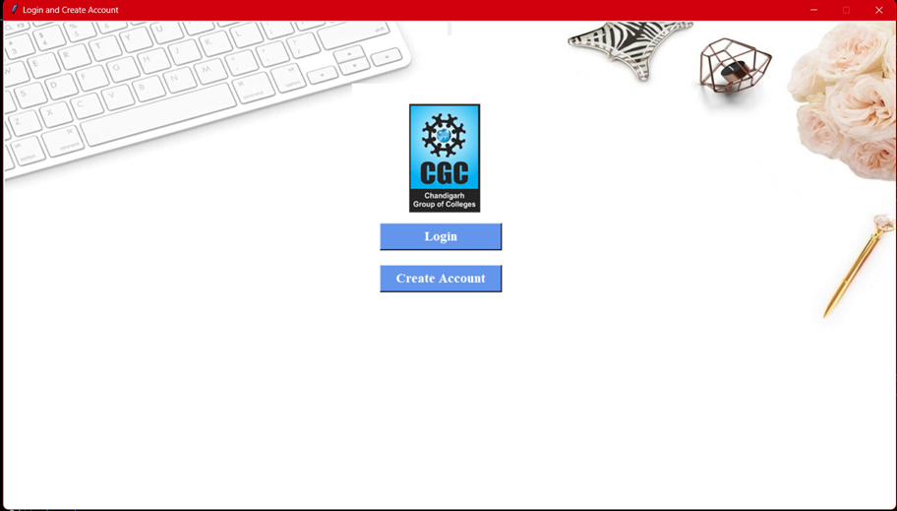
Login page

Slide 13
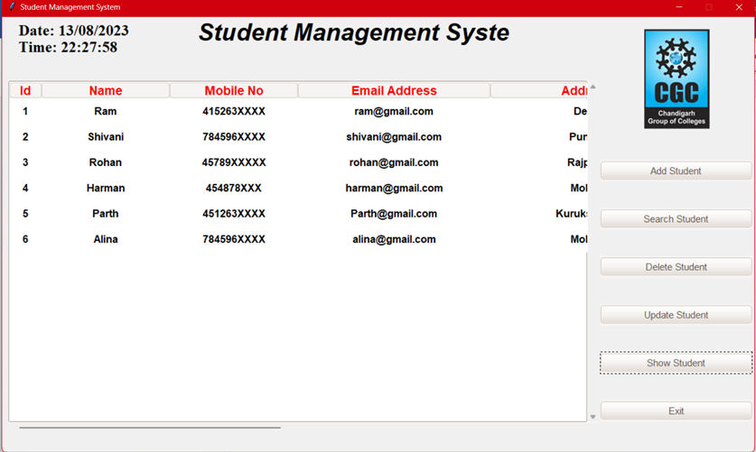
Main page

Slide 14
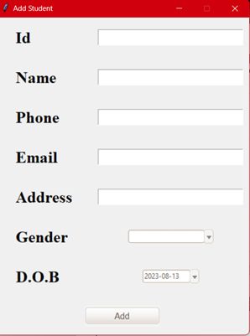
Page for adding and editing already uploaded data.

Slide 15
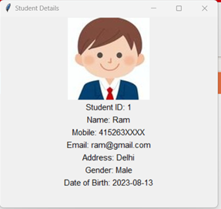
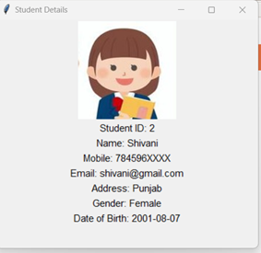
Specific student data and image

Slide 16
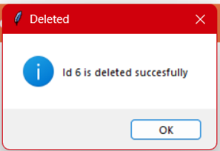
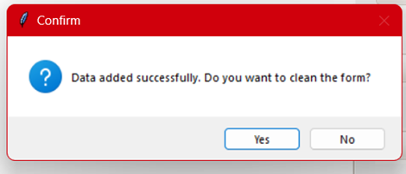
Some responsive message boxes

Slide 17
Future Enhancements:
As technology evolves, consider expanding the system's capabilities with features like image uploads for student profiles, data exporting, and advanced sorting options.
Explore how machine learning and data analytics can further enhance educational data insights.
Adding students certificates also.

Slide 18
Conclusion
In conclusion, our exploration into building a Student Management System using Python and Tkinter has showcased the power of technology in streamlining educational data management. With the ever-growing need for organized student records, this application offers a robust solution that empowers educational institutions and administrators.

